Slide 1
Lesson Overview
Stop and think- what is the difference between a component and mechanism 5 mins
Components and mechanisms- the difference and how to place them in the model 15 mins
Revise models- revise components and mechanisms in class consensus model and in students’ models in MEME 10 mins
MEME resource library- show students how to use the resource library (where evidence is stored) in MEME 5 mins
MEME connecting evidence- students will connect evidence to their model 10 mins
Good discussions- supplement- Analyze examples of discussions and discuss how to have a good discussion
Before you go- what makes a good group discussion? 5 mins
Total time: 50 mins

Slide 2


STOP & THINK!
Grab a sticky note and read the instructions!
Complete the STOP & THINK! activity.
What’s the difference between a component and a mechanism?
Pick one of the terms below
Algae, decreasing air, dissolved air, fish, growing, suffocating
Write it on your sticky note
Put the sticky note on the big paper where you think it should go: is it a component or mechanism?
Notes:
Use this “Stop & Think” as a do now.
Take a big piece of butcher paper/giant post-it and write “components” on one side and “mechanisms” on the other (like a table).
Have students take a sticky note, choose one of the terms, and place it on the paper where you think it should go.
Do not hold a class discussion at this point. Just let them do the STOP & THINK. We will discuss in the next slide.
Materials for this lesson:
We have no handout for this part of the lesson – do not hand anything out.
Later we will use the “discussions plug-in” that we didn’t get to in lesson 1. When indicated, please give students the plug-in handout with the discussions.

Slide 3
Components & Mechanisms
Algae, decreasing air, dissolved air, fish, growing, suffocating
How did you decide which was a component and which was a mechanism?
Notes:
This whole discussion (including the following 3 slides) will take 15-20 minutes.
Look at the paper where all the students stuck their sticky notes. Briefly review what people thought was what.
Ask students how they decided which was a component and which was a mechanism.

Slide 4
Components & Mechanisms
Components are things or objects. They can be living or non-living
Mechanisms are actions that components do or cause. They are often processes (things that happen)
Notes:
Here we will discuss the definitions of components and mechanisms.
For components, give some examples, like algae, dissolved air, and fish. Ask for 2-3 examples from the class. (they don’t have to be about fish/water)
For mechanisms, give an example, like, “suffocating is something that happens to the fish”; "growing is something that algae do”. Ask for 2-3 more examples from the class (they don’t have to be about fish/water)
Ask students if they have any questions/are confused.

Slide 5
Components & Mechanisms
Let’s try a few more examples. Which of the terms below are components and which are mechanisms?
Causes sleepiness
Dirty pond
Gills
Not breathing
Swimming
Water
Notes:
As a class, figure out which are components and which are mechanisms.
If students don’t agree, them to explain their reasoning. Whenever possible, ask students to respond to each other rather than to you. This can give students experience figuring ideas out together.
Causes sleepiness → mechanism
Dirty pond → component
Gills → component
Not breathing → mechanism
Swimming → mechanism
Water → component

Slide 6
Components & Mechanisms
Does the direction of the mechanism arrow matter?
Which of these makes more sense? Why?
Low dissolved air
Dead fish
Causes suffocation
Low dissolved air
Dead fish
Causes suffocation
Notes:
We want kids to understand that the direction of the mechanism arrows is meaningful.
The arrow goes from the source to the target (from the cause to the effect) (they don’t have to know these words)
Low dissolved air CAUSES SUFFOCATION of the dead fish
makes more sense than
Dead fish CAUSES SUFFOCATION of the low dissolved air

Slide 7
Revising our Class Model
Let’s look at our class model!
Based on what we talked about, do we need to change anything?
Is everything in a box really a component?
Are our arrows labeled with mechanisms?
Are our mechanism arrows pointing the way we want?
Notes:
Review & revise the class model (5-10 min)
Now that we talked about the difference between mechanisms and models, does anything need to change?
If only small things need to change you can change them on the same paper, but if big things need to change you might need to draw it on a new piece of paper. If students are still struggling/figuring out the differences between components and mechanisms, draw the model on the board first so that it’s easy to change and then transfer over to paper when students are happy with it.

Slide 8
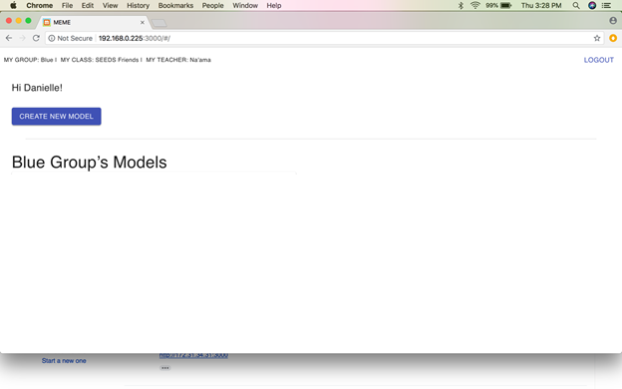
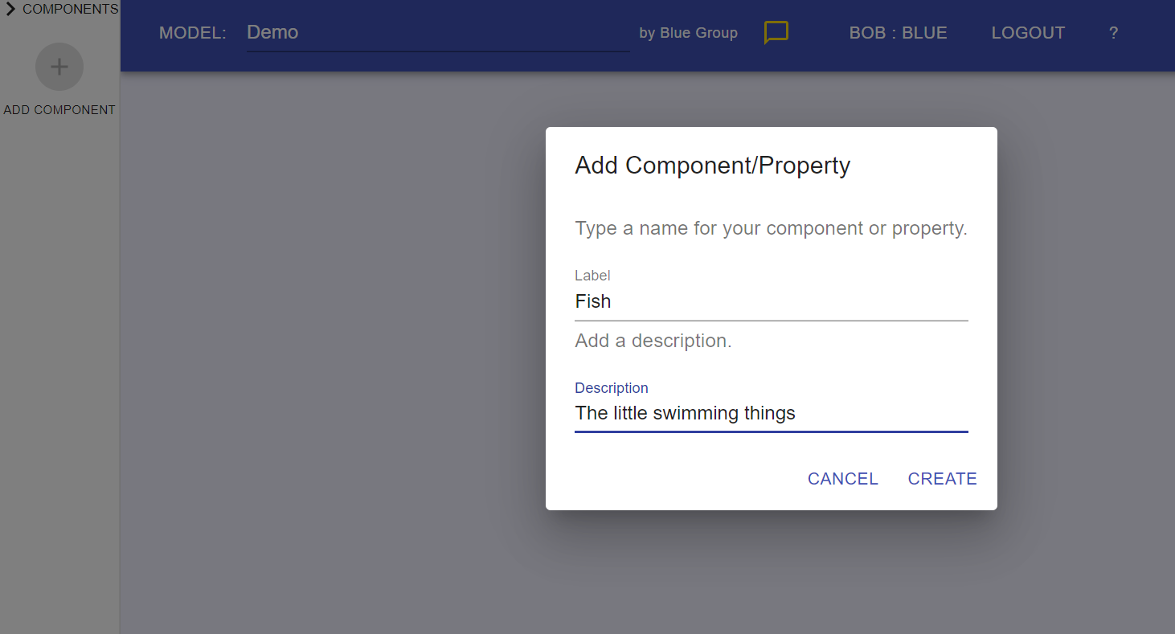
Revise Your Model
Revise your own model in MEME so that it looks like our class model.
If it’s really different from the model you made on Friday you can start a new model!
Remember to name your models!
This time, try to describe your components!
Add description
Notes:
Students adjust their models (10 min)
This time, remind them to name their models (this will be particularly necessary for students who start a new model)
(When they open their models, the name will be on the top left corner. If they need help we’ll be walking around).
Also, encourage them to add a description to their components. We may go over this in more depth at a later point if needed.

Slide 9

Why Are The Fish Dying?
Now that we made our class model, what do we still not know?
Notes:
Briefly review some major questions on the question board → focus/steer towards the question of WHY this is happening in the first place. Where did the air go?
Whenever possible, ask students to respond to each other rather than to you. This gives students practice figuring ideas out together (even in class discussions – redirect students to respond to one another rather than go to you for answers)

Slide 10
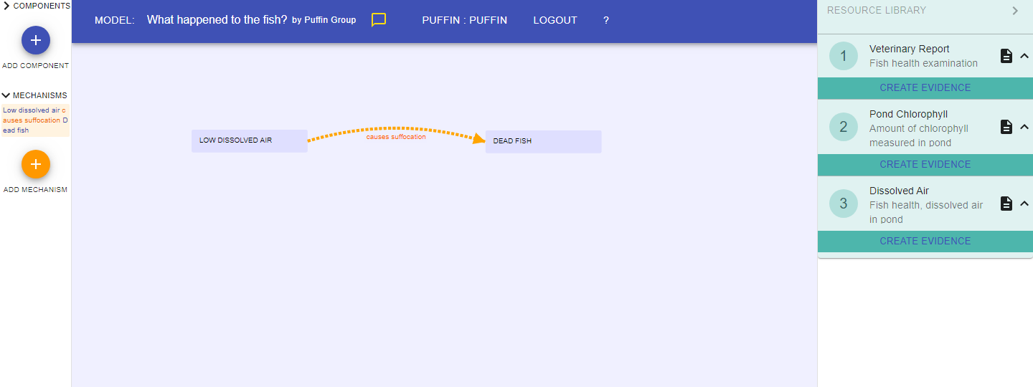
Let’s figure it out in MEME!
Let’s look at another part of MEME: a resource library!
Here you can see the scientific studies, reports, and simulations.
Notes:
This slide introduces kids to the resource library (5 minute demo)
In the next slide we will teach kids a few basic features.

Slide 11
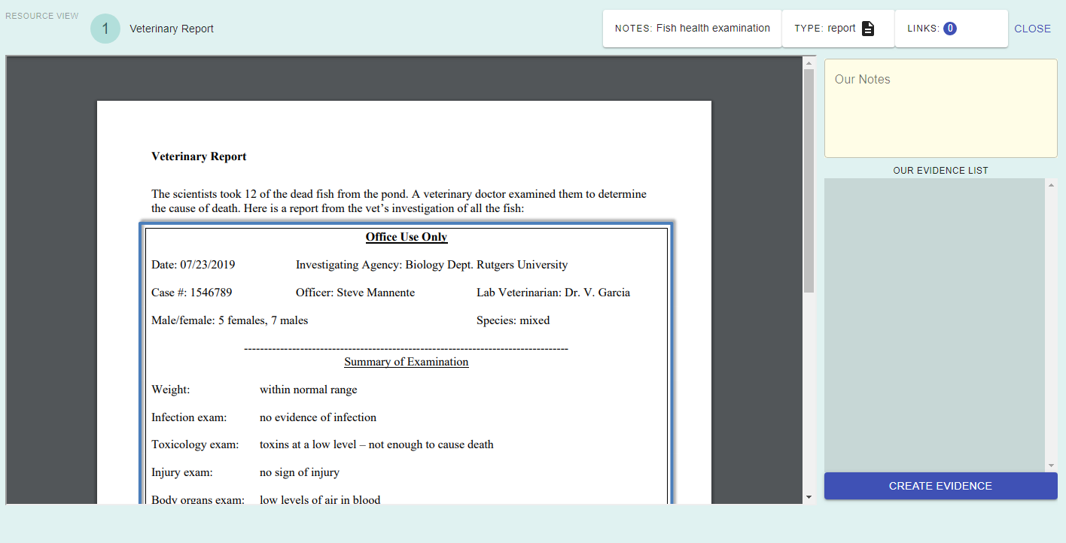
Using the Resources
When we click a resource, we can see lots of things!
Type of resource
Number and name of the resource
Add general notes
Notes:
We will be updating this image to be a study once we finalize the evidence packets.
THIS SLIDE IS ANIMATED
Walk students through the basic features, including that they can see the number and name of the resource, what type of resource it is, and general notes.
There will only be three studies in it currently.
Let kids try this out with you.

Slide 12
Supporting with Evidence
When we click a resource, we can see lots of things!
Let’s try.
Did you notice that our evidence list is empty? We haven’t made any evidence yet
Notes:
THIS SLIDE IS ANIMATED
Now we will talk with students about creating evidence.

Slide 13
Supporting with Evidence
When we click a resource, we can see lots of things!
Click here!
Notes:
THIS SLIDE IS ANIMATED
Now we will talk with students about creating evidence.

Slide 14
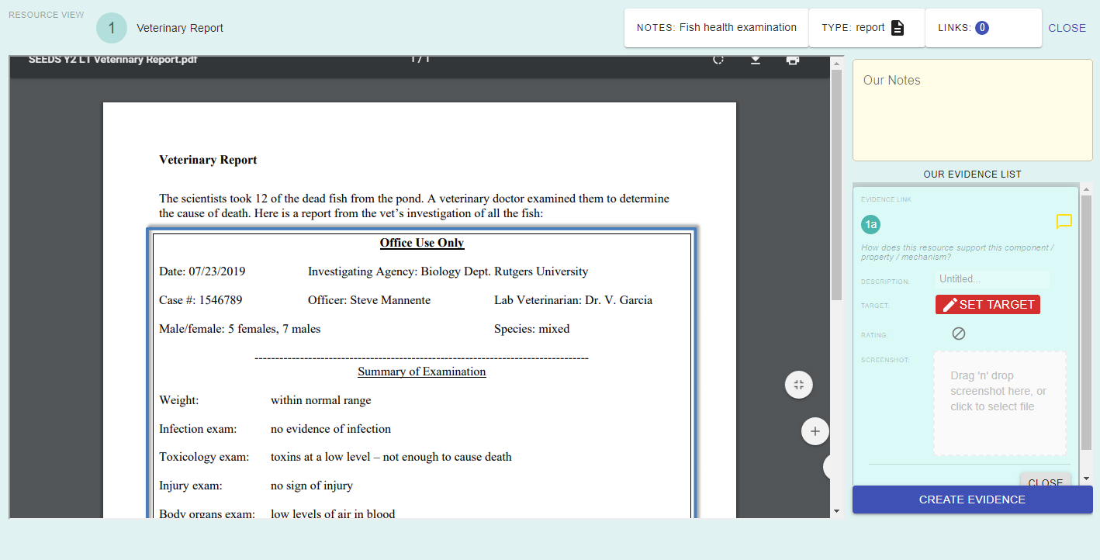
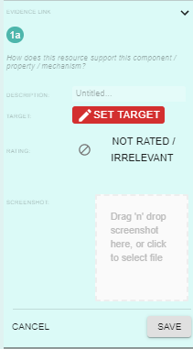
Supporting with Evidence
Describe the evidence
Notes:
This is just a quick run-through of how to make evidence.
We will be discussing how to describe evidence at a later date (probably tomorrow)

Slide 15
Supporting with Evidence
Connect to the model
Let’s try!
Notes:
You will be talking later about different ways that evidence can connect to models. For now, you can suggest that it supports a part of the model and show them how it can connect.

Slide 16
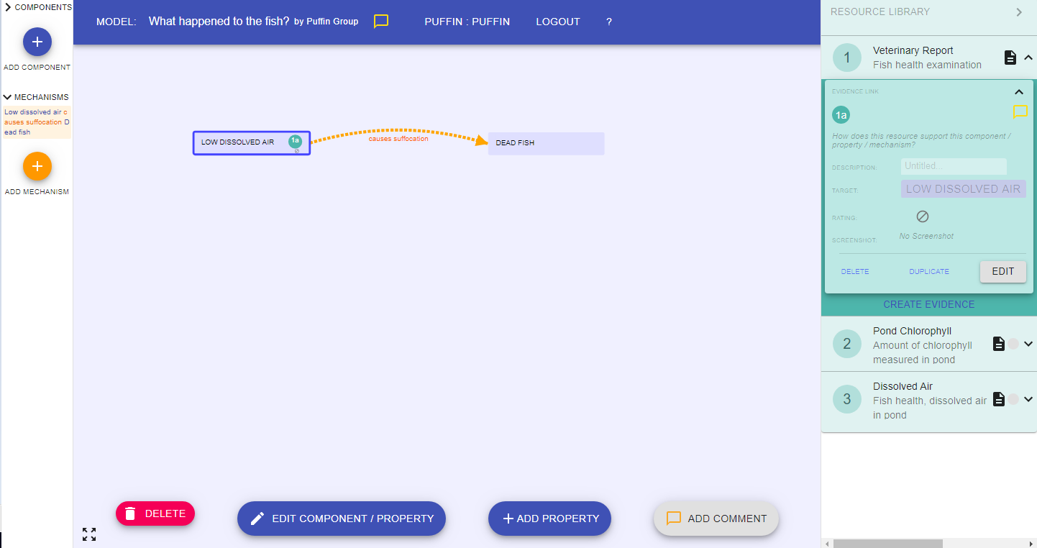


Supporting with Evidence
Now you can see the evidence connected!
And you can see it here
Notes:
THIS SLIDE IS ANIMATED
CONTINUATION OF LAST SLIDE:
You will be talking later about different ways that evidence can connect to models. For now, you can suggest that it supports a part of the model, and show them how it can connect.

Slide 17
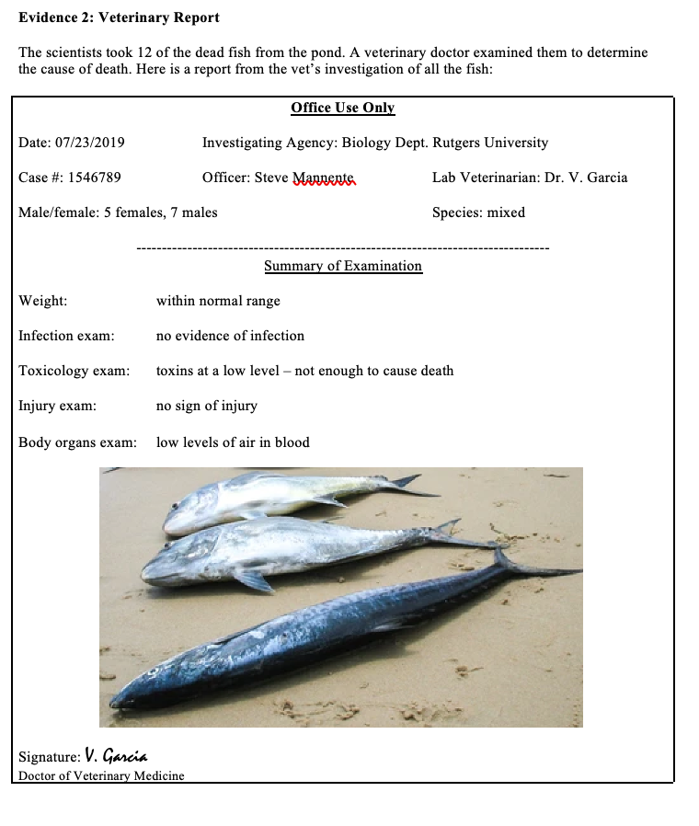
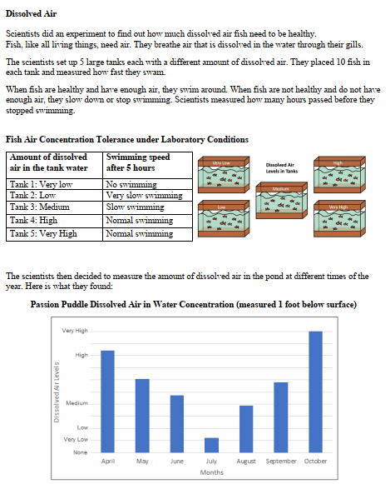
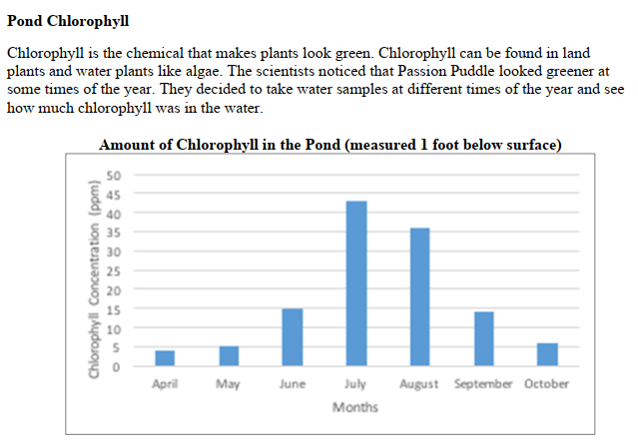
Let’s use evidence to figure out why the fish are suffocating.
With your group, try making and connecting evidence!
Evidence 1
Evidence 2
Evidence 3
Notes:
Let kids try making and connecting evidence (10 minutes)
Whenever possible, ask students to respond to each other rather than to you (remind them about their discussion stems). This should be about students figuring ideas out together. Guide them to develop their ideas as a group.

Slide 18
Notes:
Evidence 1
You do not need to go over this evidence: It’s just here in case you’d like to refer to it.

Slide 19
Notes:
Evidence 2
You do not need to go over this evidence: It’s just here in case you’d like to refer to it.

Slide 20
Notes:
Evidence 3
If you want to see this in two pieces, it’s split in two in the next two slides.
You do not need to go over this evidence: It’s just here in case you’d like to refer to it.

Slide 21
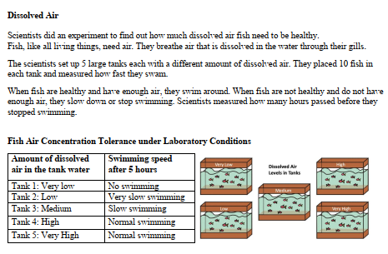
Notes:
Evidence 3, part 1
If you want to see both pieces of evidence 3, they’re all together in the slide before this one.
You do not need to go over this evidence: It’s just here in case you’d like to refer to it.

Slide 22
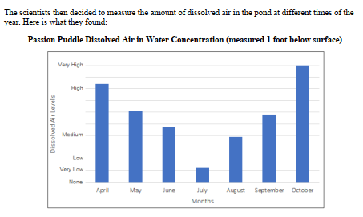
Notes:
Evidence 3, part 1
If you want to see both pieces of evidence 3, they’re all together two slides before this one.
You do not need to go over this evidence: It’s just here in case you’d like to refer to it.

Slide 23
Good DISCUSSIONS
Notes:
Have students close their computers for the day. We will not be using them for the remainder of the lesson.
This is a supplement to Lesson 2, Day 1. Since day 2 of lesson 1 will not fit into one day, shift the good discussions to day 2 and span the day 2 materials across two days.
The supplement invites students to think about what makes for a good discussion. The goal is for them to gain a better understanding of what a good discussion “looks like” and to appreciate why it is important to have good discussions.
The lesson is simple: we simply have them contrast two discussions (#1 and #2), and then they contrast the second discussion (#2) with a third one (#3). In each case, one discussion is designed to be better than the others. Through these two comparisons, we aim for students to develop a sound set of ideas about what a good discussion looks like.
Then we can work to hold students’ accountable to these ideas in subsequent group and class discussions.

Slide 24
STOP & THINK!
Grab a handout and put your name and information on the top of the first page.
Complete the STOP & THINK! question on the first page.
What makes a group discussion a good discussion?
Notes:
Hand out the supplement sheet.
Use this “Stop & Think” as an initial activity (as we take computers away) (5 minutes)
Have students fill out their details (name, class and date) then answer the Stop & Think question on their handout
Do not hold a class discussion at this point. Just let them do the STOP & THINK. (They will have a chance to articulate reasons as they discuss the examples.)

Slide 25
Which discussion is better, and why?
You’ll hear and see two discussions. Which one is better? Why?
Be ready to share your ideas and reasons with your class.
Notes:
Give these instructions to the students, and make sure everyone understands what to do. (Whole activity should be 15-25 minutes)
They will hear the two discussions, and then they can review the two discussions on their handout. In a “turn and talk” activity, they generate ideas that they are prepared to share with the class. They should of course discuss both their ideas and their reasons for their ideas. Then you will discuss their ideas with them, jotting down important characteristics of good discussions on the board. (More notes on the first two discussions follow.)

Slide 26
Which discussion is better, and why?
# 1
Kaylie: I think that parents should limit their screen time to no more than 2 hours a day.
Santiago: I agree.
Clara: I kind of think that there really doesn’t need to be a limit.
Kaylie: So, we have two different ideas. Santiago and I think there should be a limit, and you don’t think so.
Notes:
Ask three students to come to the front of the class and act out this short discussion. (The discussion is on their handout.)

Slide 27
Which discussion is better, and why?
# 2
Troy: I think that parents should limit their screen time to no more than 2 hours a day.
Jasmine: Why do you think so?
Troy: Well, if you spend so much time sitting and looking at the screen, you don’t get enough exercise, and the report we read showed that kids need a lot of exercise to be healthy.
Jasmine: Oh, I didn’t think of that.
Devon: I have a different idea. I don’t think there needs to be a limit, because a lot of what we see is educational, and we can learn a lot from that.
Jasmine: OK, so we have two different ideas, and we all have some good reasons.
Notes:
Ask three different students to come to the front of the class and act out this short discussion. (The discussion is on their handout.)

Slide 28
Which discussion is better, and why?
#1 or #2 ?
Notes:
Our hope is that students will raise these ideas themselves, given time to share and develop their ideas.
In Discussion #1, the three students simply state their position, without giving any reasons.
In Discussion #2, two of the three students give reasons. Jasmine asks for a reason.
Jasmine points to why giving reasons is important; you learn new things.
Troy mentions reading a report, which shows that he is using information that the class has read.
It could also be viewed as a good thing to summarize what everyone thinks, and both discussions do this.
Students may of course have other relevant ideas.
In follow up questions, ask why the characteristics they propose are good. (For example, "Why is it good to give reasons?”)
Of course, students may note that #2 is longer than #1. But longer discussions need not be better; a long discussion could be long because it goes off on tangents, and then it wouldn’t be better. What matters is what makes it longer: The added reasons make it longer, and the reasons are a good thing because they can help you understand better and have better grounds for believing what you believe.
As students discuss their ideas, jot down the important characteristics of good discussions that they bring up on the board.

Slide 29
Which discussion is better, and why?
Now we’ll compare discussions #2 and #3 in the same way.
As before, be ready to share your ideas and reasons with the class.
Notes:
Ask students to repeat this set of activities for a new comparison, between Discussions #2 and #3.

Slide 30
Now compare #2 and #3.
# 2
Troy: I think that parents should limit their screen time to no more than 2 hours a day.
Jasmine: Why do you think so?
Troy: Well, if you spend so much time sitting and looking at the screen, you don’t get enough exercise, and the report we read showed that kids need a lot of exercise to be healthy.
Jasmine: Oh, I didn’t think of that.
Devon: I have a different idea. I don’t think there needs to be a limit, because a lot of what we see is educational, and we can learn a lot from that.
Jasmine: OK, so we have two different ideas, and we all have some good reasons.
Notes:
Tell students that the first discussion in the comparison is Discussion #2, which is the discussion they have already been examining.

Slide 31
# 3
James: I think that it would be good if parents say that their children should keep their screen time to no more than 2 hours a day.
Serena: Why do you think that?
James: One reason is that when you’re on the screen many hours each day, you aren’t getting exercise, and people need a lot of exercise.
Lia: I think that’s a good point, James. But I think we can still get a lot of exercise even if we spend, like, 2 hours a day on the screen. Like, I can go outside and play for two hours after school, and then still have time in the evening.
James: We also read that educational videos help kids learn, and there are lots of good educational games too.
Serena: I agree that educational videos are good, and sometimes we get homework that requires us to go online.
Lia: These are really good reasons. Maybe we can decide that the two hours of screen time doesn’t include educational stuff or homework.
Notes:
Ask three new students to come to the front of the class and act out this short discussion. (The discussion is on their handout.)

Slide 32
Which discussion is better, and why?
#2 or #3 ?
Notes:
As before, our hope is that students will raise these ideas themselves, but students may need more time to develop these ideas.
As before, students may note that #2 is longer than #1. But as before, longer discussions need not be better; it depends on whether what makes them long is productive.
As noted earlier: In Discussion #2, two of the three students give reasons. Jasmine asks for a reason.
Jasmine points to why giving reasons is important; you learn new things.
But there is no building on ideas in any way.
In Discussion #3, there is a lot more going on.
As in #2, a student (Serena) asked for a reason, which is good, and similar in both.
In #3, James gives a reason that more than two hours of screen time would reduce exercise. And then Lia critiques this reason, suggesting that you can still get enough exercise even if you have more than two hours of screen time. So students are not just accepting reasons at face value.
Then Serena elaborates on James’s reason, adding more details to why educational videos might help.
James’s comment also indicates that they are using information they have read (We also read that educational videos help kids learn.” This is a positive point shared with #2 (in #2, Troy mentions a “report” they read.)
Lia takes the contrary arguments and proposes a kind of compromise solution; this suggests that she is using the new information to change her ideas.
Students may of course have other relevant ideas.
In follow up questions, ask why the characteristics they propose are good. (For example, "Why is it good to give reasons?”)
As students discuss their ideas, jot down the important characteristics of good discussions that they bring up on the board.

Slide 33
BEFORE YOU GO
Complete the BEFORE YOU GO question.
What makes a group discussion a good discussion?
Notes:
END OF DAY 1
Use this “Before You Go” as an exit ticket. It is the same as the “stop & think”. IF students ask about this, tell them that we would like to see if/how their ideas changed.
Emphasize to students that they can use these new ideas to have better group AND class discussions.

